Slide 1

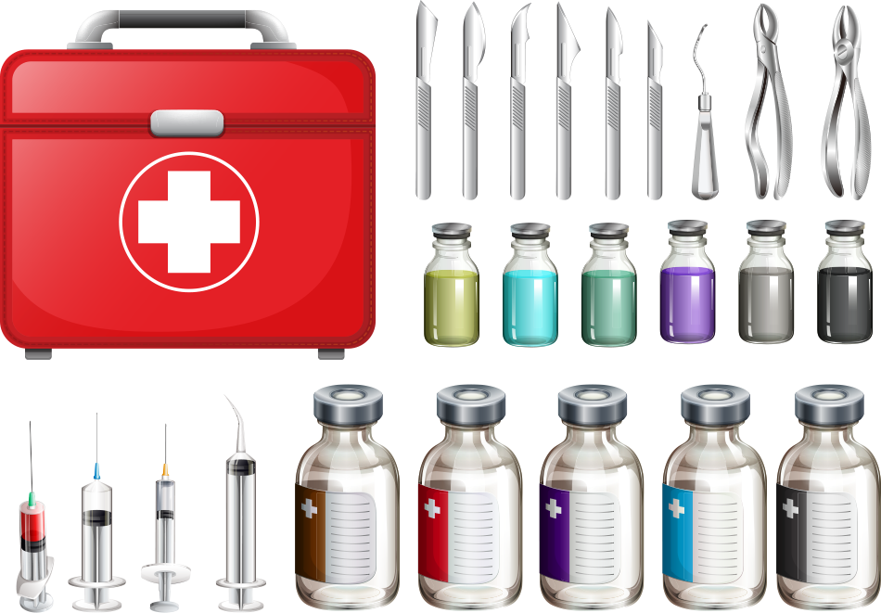
Supply Chain Management
ASCM Case study
Navigating Pandemic Supply Challenges
for
MediCrystals Co.

Slide 2
Team Members
Sneha Kumari | 20IM30020
Suvigya Saxena | 20IM30022
Tarole Vedant | 20IM30023
Trisha Pravin Sarwade | 20IM30024
Udit Jain | 20IM30025

Slide 3
Table of contents
Problem Definition
Research Question
Objectives
Methodology - Solution Approach
Results & Discussion
Implications
Notes:
Bro ja prom ki tayyari kar…. :)

Slide 4

MediCrystals Co.
MediCrystals Co. is a leading German pharmaceutical glass manufacturer
They offer a solution for the entire range of basic volume tubular glass parenteral packaging.
They have customers all over the world and supplies to over 120 countries.
They have signed agreements with major pharmaceutical firms to supply pharma glass products for the packaging of two billion doses of Covid-19 vaccines.
They manufacture over 8 billion pharma glass containers for drugs annually.

Slide 5
The COVID-19 pandemic has exposed critical vulnerabilities in our pharmaceutical supply chain.
~Abigail Spanberger

Slide 6

Research Questions:
(i) Developing a high level risk scoring methodology.
(ii) Identify other risk domains.
(iii)Estimating the change in the inventory position to understand the working capital impact
(iv)Estimating the potential obsolete inventory that they currently have.
(v)Evaluating if there is a capacity constraint for Fabricadas. Explain why the Plant Manager feels the capacity is inadequate against the VP.
(vi)Recommendations on maximizing utilization to meet the demand at current capacity.

Slide 7

supplier’s

Slide 8
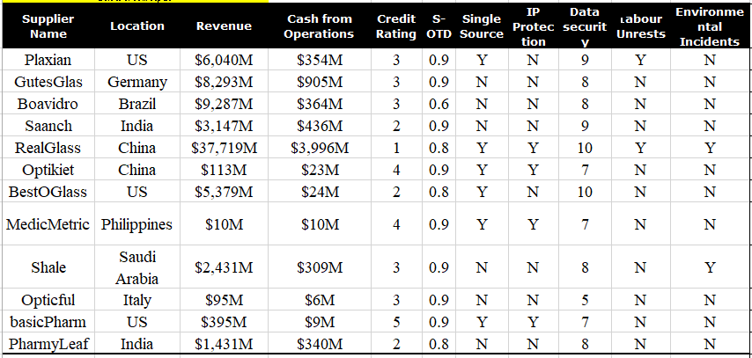
Data Table

Slide 9
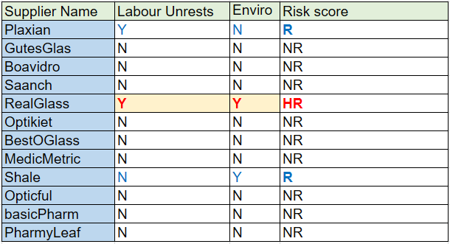
Regulatory risk scores
RealGlass is the only supplier to face both kind of situations in past 12 months while Plaxian and Shale faced Labour unrests and Shale respectively.
Equivalent scores
HR-0
R-0.5
NR-1
Equal weightage assigned to both measures
Labour Unrest - Y" indicates if the supplier has faced any labor unrests in the past 12 months. "N" if no labor unrests have been faced by the supplier in the past 12 months
Environmental risk- “Y" indicates if the supplier has faced any environmental incidents in the past 12 months. "N" if no environmental incidents have been faced by the supplier in the past 12 months

Slide 10
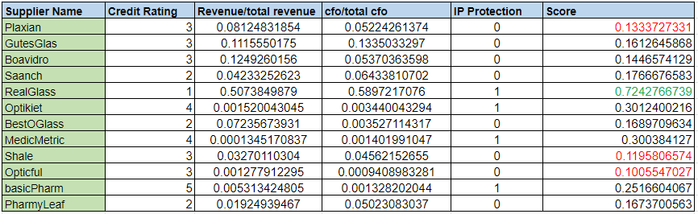
Financial risk scores

Slide 11
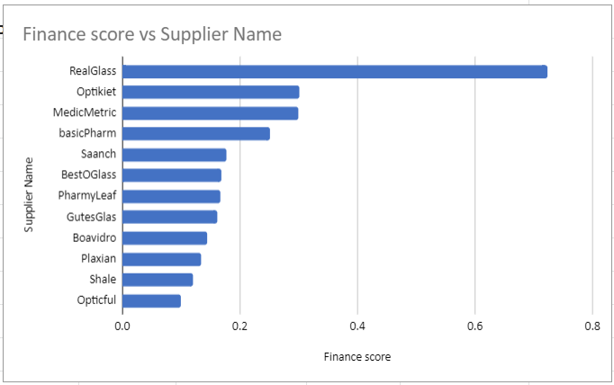
Credit Rating - Data collected by D&B
Range of 1 to 4 (1 – low risk; 4 – high risk); 1 indicates a minimal risk and 4 indicates a significant level of risk
Lower the credit rating in number better it is. So while calculating the score We recalculated it as 5-credit score to match the monotony of the score then normalised to 0-1 range.
Revenue ratio- We compared the revenue of a supplier to the overall revenue of all the suppliers to get an idea of the contribution in the market.
Cash from Operations(CfO)- Indicates the amount of money a company brings in from its ongoing, regular business activities. It is calculated by dividing cfo to total cfo of all the suppliers.
IP Protection- IP protection safeguards ones' original works such as inventions, designs, brand names, software codes, etc., via legal methods such as patents, trademarks and copyrights.
1- if the supplier owns an IP for the product supplied and 0 if the supplier doesn't own any IP
Equal weightage of all the four scores were taken to deduce the final Financial risk score, lower the score less trustworthy the supplier is.
Suppliers Opticful, Shale, and Plaxian scored the least and RealGlass came out to be exceptionally well in terms of Financial state.

Slide 12
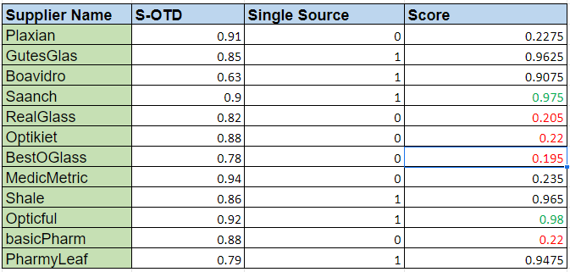
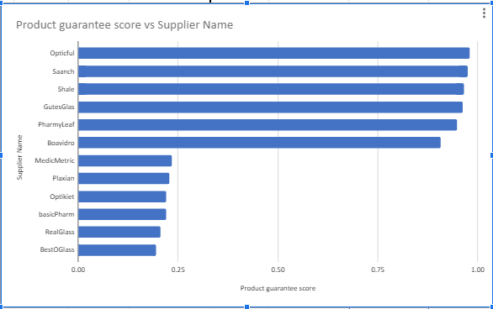
Product Delivery score
S-OTD Supplier On-time delivery (S-OTD) performance for the past 12 months 1-best performance 0- poor performance
Single Source- whether the supplier get his glass supply from single supplier or not.
0-yes ; 1-no
Final score is calculated giving 25% weightage to S-OTD and 75% to single source score, reason behind is single score is more heavy factor to judge the capability of a supplier than on time delivery. Suppliers Bestoglass, Realglass, Optiket and basicPharm were among the least scorers while Saanch, Opticful were the ones with high scores.

Slide 13
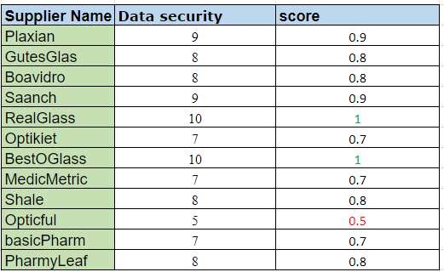
cyber risk scores
Realglass and Bestoglass with an absolute score while Opticful is the least scorer.
Data security - Internal scoring done for each supplier by MediCrystals assessing supplier's systems & Data security on a scale of 0-10 (10 indicates excellent systems & data security and 0 indicates very poor systems & data security). We scaled it to 1 by dividing by 10.

Slide 14
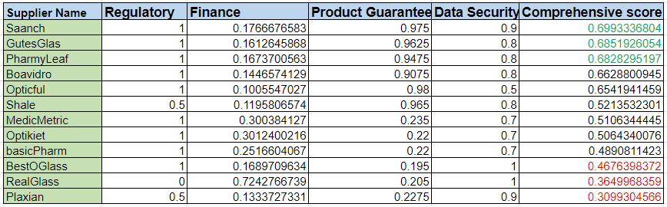
Comprehensive score
To calculate the final comprehensive score we assigned 30% weightage to Regulatory score, 35% to finance score, 30% product guarantee score and remaining 5% to data security score. The weightage were decided by the impact of that study on the overall analysis which we tried find out from statistics of successful supply chain companies.

Slide 15
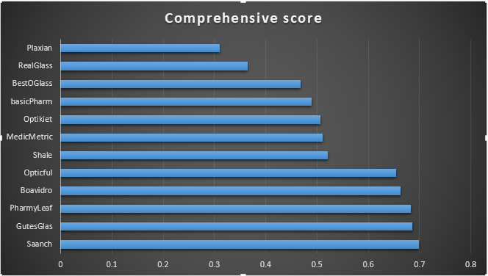
Conclusion after scoring the suppliers
After calculating the comprehensive score we are now in a position to comment on the suppliers trustworthiness.
The worst performance suppliers are Plaxian, RealGlass, and BestOGlass,
Saanch, Gutesglas and PharmyLeaf are the overall high scorers and can be trusted for the continuous supplies in an emergency situation.

Slide 16

estimating the change in the inventory position to understand the working capital impact in GlasWork, Switzerland

Slide 17

Inventory savings in switzerland
Forecasted Demand is calculated as:
[(APU Units) + (APU Trend * APU Units)] * (Demand Variability)
Production required is calculated as:
Max(0, ([Demand Forecasted * Std. Price - On-Hand Stock]/std. Price))
Where, Total SKUs = 2010
SKU - SKU Number
Std. Price ($) - Price of each unit of SKU
On-Hand Stock ($) - Total stock on-hand as of 30th Sep'20
APU (units) - Average monthly consumption (30 days) of the SKU
APU Trend - Anticipated APU trend provided by marketing (e.g. 50% indicates 50% increase in APU consumption)
S-OTD - Supplier On-time delivery (S-OTD) performance for the past 12 months
Demand variability (COV) - Demand Coefficient of variance for the past 12 months
Lead Time (days) - Lead time in days to procure the SKU

Slide 18
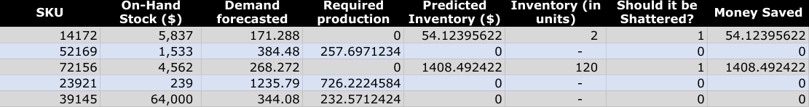
Change in inventory
Change in inventory:
Current inventory value | Predicted inventory value | Difference
46,008,200 | 21612311.72 | 53.02508721 %
The current inventory value is the total on hand stock.
Predicted inventory value is calculated as:
Max(0, (On-Hand Stock) - (Std Price*Demand Forecasted))

Slide 19
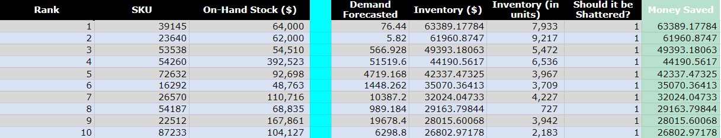
Potential obsolete inventory in switzerland
Total SKUs to be shattered | Money saved from shattering
244 | 1091773.618
IF Inventory(in units)>0 AND Lead Time<30 THEN shatter (1), ELSE don’t shatter (0)
Money saved from shattering is calculated by:
(Predicted Inventory($)) * (Should it be shattered?)

Slide 20
$ 982,596.26
Out of 244 SKUs, top 73 SKUs correspond to 90% of Obsolete Inventory (in $).

Slide 21


Do fabricadas, the new facility in Chicago have
capacity constraint?

Slide 22
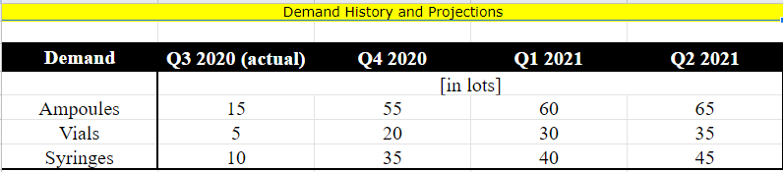
Demand data for products from fabricadas

Slide 23
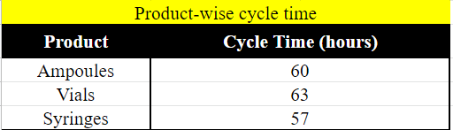
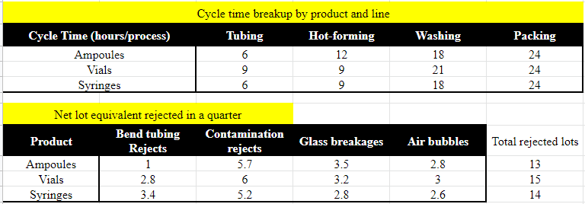
Cycle time and net lot rejected

Slide 24
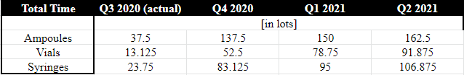
Time in days required for production at Fabricadas
If forecast is taken to be exact demand (VP Operations) :
It can be clearly seen that Fabricadas is able to produce the required number of products for vials and syringes without much constraints till 2nd Quarter of 2021.
This is the reason why the VP Operations for MediCrystals is certain that there is enough capacity to meet the requirements

Slide 25
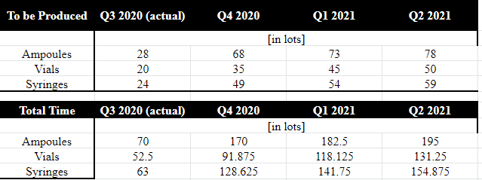
Time in days required for production at Fabricadas
When Rejection of lot is taken in account (Plant Manager):
Fabricadas is not able to produce the required number of products for any of the product type from 4th Quarter 2020 onwards.
(A quarter =90 days while production time required >>>> 90 days.)
If defects are taken in consideration, the anticipated production requirement goes significantly up and Fabricadas would have to face huge capacity constraint problems.
Hence, the Plant Manager feels that fabricadas has capacity constraint.

Slide 26
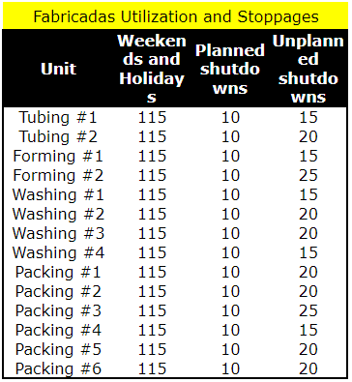
Now, let’s take a look at their working days and stoppages…
According to the plans shared with the team, steps for manufacturing is said to have the following processes : the glass tubing capacity unit, the hot-forming process unit that creates the required shape, washing and inspection unit and finally the packing and distribution unit.
Each plant manufactures the three products: Ampoules, Tubular Vials and Glass Syringes. Each product has its own separate movement through the manufacturing chain.
Out of 365 days, the plant does not operate for 140-150 days.
Weekends and holidays constitute a major portion of the non-working days of the plant at Fabricadas.

Slide 27
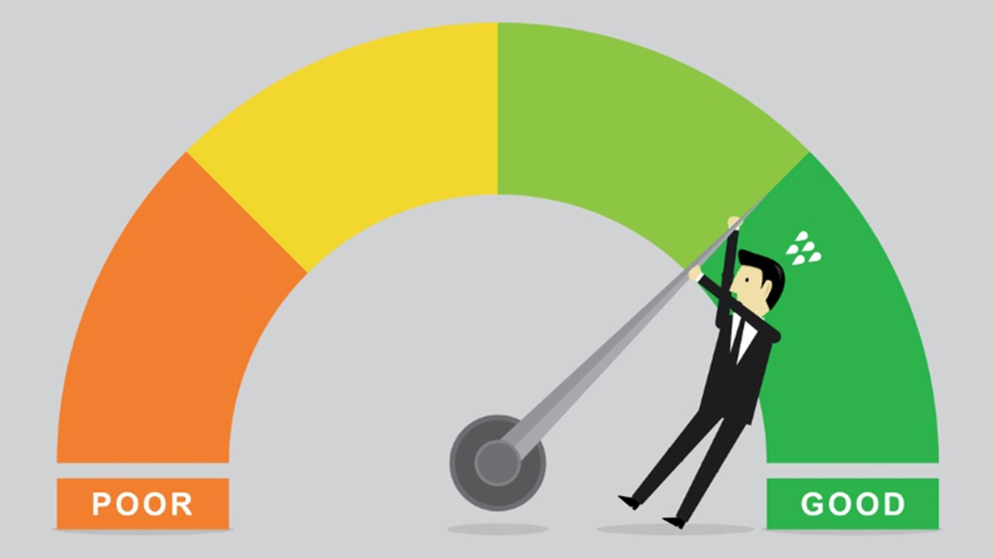
Can the efficiency of fabricadas be improved?

Slide 28
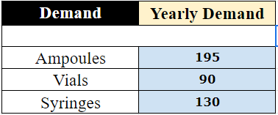
What Happens If We Adopt 365 Days 24x7 Continuous Production?
 | Current Production(16hrs) | New Production(24 hours) | Improvement
Working days (w/o shutdowns) | 250 | 365 | 46%
Ampoules (w/o rejections) | 66 | 146 | 121.2121212%
Vials (w/o rejections) | 63 | 139 | 120.6349206%
Syringes (w/o rejections) | 70 | 153 | 118.5714286%

Slide 29
Recommendations
Remove Weekends and Holidays to make the plant run for 365 days.
Workers can be given day-off on different days but the plant should run throughout week.
Increase production hour per day from 16 hrs to 24 hrs.
Again, Workers can be called at 3 different shift (8 hrs each).
Progressive maintenance can be adopted to minimize the downtime i.e. reduce the number of shutdowns.

Slide 30
Thanks!
Excel Link:
https://docs.google.com/spreadsheets/d/1ke5l4oifKTkgPvogJFNWdbFuFGlDjXCw/edit?usp=sharing&ouid=115885838738045519707&rtpof=true&sd=true

